Slide 1
Connect Handy
presents :
Handi’Tab

Slide 2
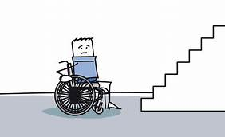

Slide 3
